Slide 1
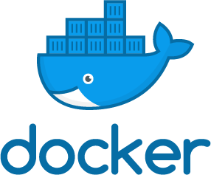

Docker: Starting Small
For Docker Ottawa Meetup
by: Patrick Santos

Slide 2
Overview
Docker at small scale: My use case
Why get started with Docker
  (if you already have VMs)
How to start using Docker
Demos: Basics
Experienced users can start sleeping here

Slide 3
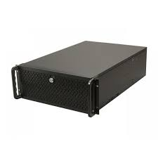
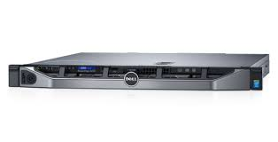
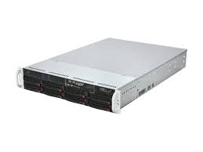
Docker at Small Scale (+why)
Heterogeneous servers from:
  Research projects / demos
  TCO calculation vs cloud
Docker helps
  Better scaling
  Setup / teardown

Slide 4
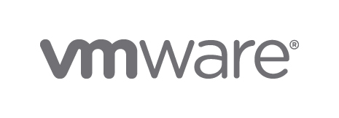


I : Why Docker?
Docker works with your VMs (+ other tooling)
Speed to spin up / tear down
  Seconds versus minutes
Resource consolidation
  ↓30-35% storage, ↓7% RAM, ↓25% compute [1]

Slide 5
How do I start?
Install Docker on your machine: https://store.docker.com/search?type=edition&offering=community
Play around / learn: https://github.com/docker/labs
Find something to “Dockerize”

Slide 6
First Docker Victim Candidate
VM: Jenkins Master
Not in production!
Docker image available
Ephemeral
VM: Jenkins Slave
VM: Smoke test DB
VM: Release Test Runner
VM: Release Test DB 1
VM: Release Test DB 2
Test setup before Docker

Slide 7
First Experiments
Run a Docker container
  docker run --rm -it ubuntu:16.04 /bin/bash
Check the space savings versus VM
  docker ps
  docker inspect
Try pipes with it!
  docker run ubuntu:16.04 echo hello | tee .docker.out
[2]

Slide 8
Replacing a Database VM - 1
Find suitable container
  PostgreSQL: https://store.docker.com/images/postgres
Note – official images:
  Community containers have a username, e.g. docker pull circleci/postgres

Slide 9
Replacing a Database VM - 2
Look in hub.docker.com or store.docker.com page for instructions
start a postgres instance
$ docker run --name some-postgres -e POSTGRES_PASSWORD=mysecretpassword -d postgres
This image includes EXPOSE 5432 (the postgres port), so standard container linking will make it automatically available to the linked containers. The default postgres user and database are created in the entrypoint with initdb.

Slide 10
Connecting to the Database
With another Docker container
  []
Native process from the same machine
  Watch port or firewall rules
Expose port from another machine
  []

Slide 11
Next Steps
Docker volumes to persist data
  https://docs.docker.com/engine/admin/volumes/volumes
Learn more:
  https://github.com/docker/labs
  Creating your own Dockerfile
  Docker Swarm mode

Slide 12
Suppl: Docker vs VMs

Slide 13
Caveat: Checking containers
For security conscious: Auditing still applies!
Example insecure Dockerfile:
# Install Kafka, Zookeeper and other needed things
RUN apt-get update && \
apt-get install -y zookeeper wget supervisor dnsutils && \
rm -rf /var/lib/apt/lists/* && \
apt-get clean && \
wget -q http://apache.mirrors.spacedump.net/kafka/ (...) && \
tar xfz /tmp/kafka_"$SCALA_VERSION"-"$KAFKA_VERSION".tgz -C /opt && \
rm /tmp/kafka_"$SCALA_VERSION"-"$KAFKA_VERSION".tgz

Slide 14
References
[1] Mike Coleman. 2017. Docker?!? But I'm a SYSADMIN! Retrieved Aug. 11, 2017, from https://youtu.be/M7ZBF-JJWVU
[2] Docker. 2017. Running your first container. Retrieved Aug. 16, 2017, from https://github.com/docker/labs/blob/master/beginner/chapters/alpine.md[3] Docker. 2017. postgres. Retrieved Aug. 16, 2017, from https://store.docker.com/images/postgres

